Slide 1
LINUX
INTRODUCTION AND BASIC COMMANDS

Slide 2
File and directory commands
ls: The ls command is used to list files or directories. It also accepts some flags or options that changes how files or directories are listed in your terminal.
ls: The ls command is used to list files or directories. It also accepts some flags or options that changes how files or directories are listed in your terminal.
The option '-p' is used to create multiple directories or parent directories at once.
$ mkdir -p dir1/dir2/dir3
pwd The pwd(Present Working Directory) command is used to print the name of the present/current working directory starting from the root.
ls: The ls command is used to list files or directories. It also accepts some flags or options that changes how files or directories are listed in your terminal.
mkdir: The mkdir(make directory) command allows users to create directories or folders. The option '-p' is used to create multiple directories or parent directories at once.
$ mkdir -p dir1/dir2/dir3

Slide 3
Remove entire directory tree. This command is similar to rmdir a/b/c a/b a:
rmdir -p a/b/c
rmdir: The rmdir(remove directories) is used to remove empty directories. Can be used to delete multiple empty directories as well. Safer to use compared to rm -r FolderName. This command can also be forced to delete non-empty directories.
Remove empty directory:
rmdir FolderName
Remove multiple directories:
rmdir FolderName1 FolderName2 FolderName3
Remove entire directory tree. This command is similar to rmdir a/b/c a/b a:
rmdir -p a/b/c

Slide 4
rm file_name
rm: The rm(remove) command is used to remove objects such as files, directories, symbolic links etc from the file system.
rm file_name
Remove file forcefully: The rm command with -f option is used for removal of file without prompting for confirmation.
rm -f filename
Remove directory:
The rm command with -r option is used to remove the directory and its contents recursively.
rm -r myDir
Remove directory forcefully:
The rm command with -rf option is used to forcefully remove directory recursively.
rm -rf myDir

Slide 5
touch: The touch command is is used to create, change and modify timestamps of a file without any content.
touch file_name
Create multiple files: You can create the multiple numbers of files at the same time.
touch file1 file2 file3
cat: The cat command is used to create single or multiple files, view contain of file, concatenate files and redirect output in terminal or files.
Create a file: Used to create a file with specific name, content and press exit using CTRL + D
cat > file_name1.txt
Hello, How are you?

Slide 6
View file contents: You can view contents of a single or more files by mentioning the filenames.
cat file1
More:it is also used to see the content inside the file
more file
more and cat commands are working in similar way

Slide 7
File permissions
Since Linux is a multi-user operating system, it is necessary to provide security to prevent people from accessing each other’s confidential files. So Linux divides authorization into 2 levels,
Ownership: Each file or directory has assigned with 3 types of owners i. User: Owner of the file who created it.
ii. Group: Group of users with the same access permissions to the file or directory.
iii. Other: Applies to all other users on the system

Slide 8
Permissions: Each file or directory has following permissions for the above 3 types of owners.
i. Read: Give you the authority to open and read a file and lists its content for a directory.
ii. Write: Give you the authority to modify the contents of a file and add, remove and rename files stored in the directory.
iii. Execute: Give you the authority to run the program in Unix/Linux.

Slide 9
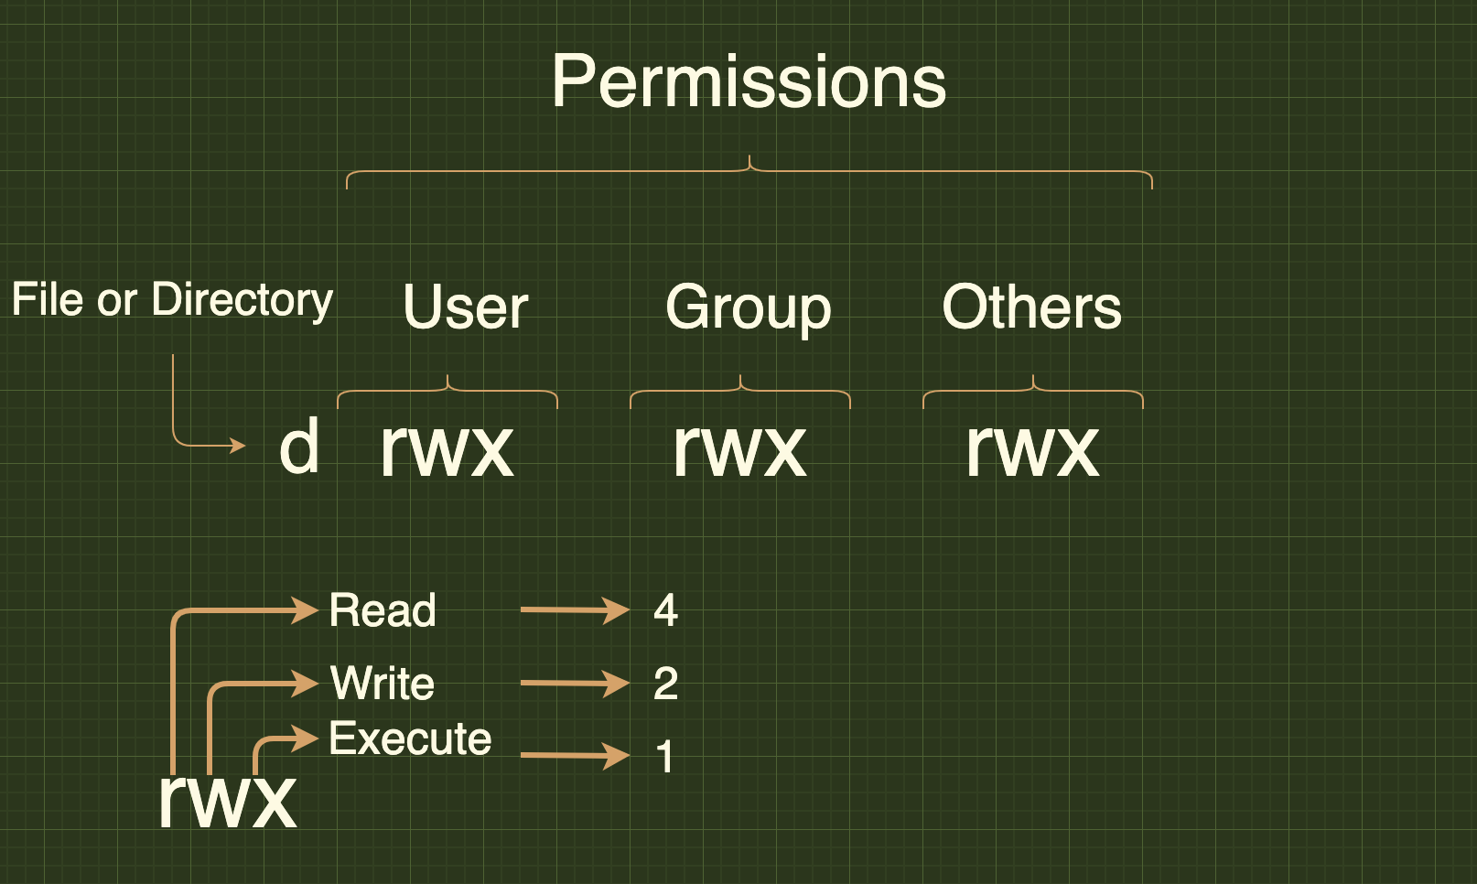

Slide 10
Absolute mode:
The possible permissions types represented in a number format as below.
Permission Type | Number | Symbol
No Permission | 0 | ---
Execute | 1 | --x
Write | 2 | -w-
Execute + Write | 3 | -wx
Read | 4 | r--
Read + Execute | 5 | r-x
Read + Write | 6 | rw-
Read + Write + Execute | 7 | rwx

Slide 11
Symbolic mode: In the symbolic mode, you can modify permissions of a specific owner unlike absolute mode.
The owners are represented as below,
owner | Description
u | user/owner
g | group
o | other
a | all

Slide 12
Mathematical symbol method:
Operator | Description
+ | Adds permission
- | Removes the permission
= | Assign the permission

Slide 13
chown user filename chown user:group filename
Changing Ownership and Group: It is possible to change the the ownership and group of a file/directory using chown command.
chown user filename
chown user:group filename
Example:
chown John test.txt
chown John:Admin test.txt

Slide 14
Change group-owner only: Sometimes you may need to change group owner only. In this case, chgrp command need to be used
chgrp group_name filename
Example:
sudo chgrp Administrator test.txt

Slide 15
Networking:
Display network information: ifconfig command is used to display all network information(ip address, ports etc)
ifconfig -a
Test connection to a remote machine: Send an echo request to test connection of a rehostname -I
(OR)
ip addr showmote machine.
ping <ip-address> or hostname
Show IP Address: Display ip address of a currennt machine
hostname -I
(OR)
ip addr show

Slide 16
Active ports: Shows active or listening ports
netstat –pnltu
Synopsis:
du command is used to check the information of disk usage of files and directories on a machine
Disk usage of a directory:
To find out the disk usage summary of a /home/ directory tree and each of its sub directories
du /home/

Slide 17
Disk usage in human readable format: To find out the disk usage in human readable format
du -h /home/
Total disk usage of a directory: To find out the total disk usage
du -sh /home/
Total disk usage of all files and directories: To find out the total disk usage of files and directories
du -ah /home/

Slide 18
Help: This command gives information about du
du --help

Slide 19
System and Hardware information:
Print all information: uname is mainly used to print system information.
$ uname -a
Print kernel name:
$ uname -s
Print kernel release:
$ uname -r
Print Architecture:
$ uname -m
Print Operating System:
$ uname -o

Slide 20
Search Files
Pattern search: The grep command is used to search patterns in files.
grep pattern files
grep -i // Case sensitive
grep -r // Recursive
grep -v // Inverted search
Example:
grep "^hello" test.txt // Hello John
grep -i "hELLo" text.txt // Hello John

Slide 21
Find files and directories:
The find command is used to find or search files and directories by file name, folder name, creation date, modification date, owner and permissions etc and perform subsequent operations on them.
. Search file with name:
find ./directory_name -name file_name
Example:
find ./test -name test.txt // ./test/test.txt

Slide 22
Search for empty files or directories:
find ./directory_name -empty
The find command is used to search all empty folders and files in the entered directory or sub-directories.
find ./directory_name –empty
Example:
find ./test –empty
Locate to find files: The locate command is used to find the files by name. This command is faster compared to find command because it searches database for the filename instead of searching your filesystem.
locate [OPTION] PATTERN
Example:
locate "*.txt" -n 10 // 10 file search results ending with .txt extension

